Slide 1
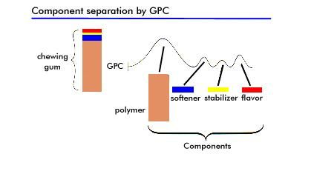
Size-Exclusion Chromatography
Gel permeation chromatography (GPC)
http://www.waters.com/waters/en_TH/Size-exclusion-chromatography-%28SEC%29-Gel-Permeation-Chromatography-%28GPC%29-Guide/nav.htm?cid=10167568&locale=en_TH

Slide 2
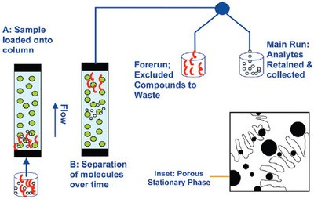
Cross sectional view of porous particle
https://www.studyread.com/gel-permeation-chromatography/

Slide 3
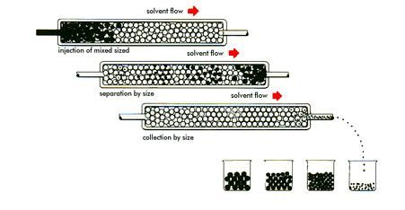
The Size Separation Mechanism

Slide 4
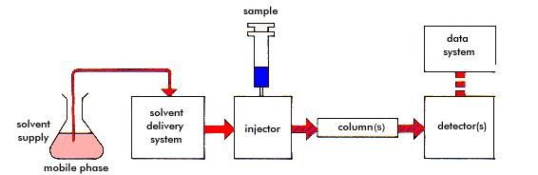
Schematic of a basic gel permeation chromatograph
differential refractometer (RI)
Consideration
Mobile phase
Sample preparation
Column
Solvent delivery system (pump)

Slide 5
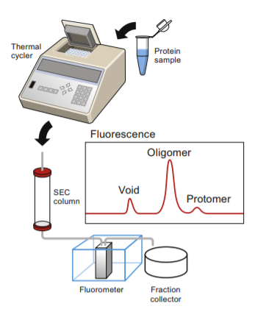

Slide 6
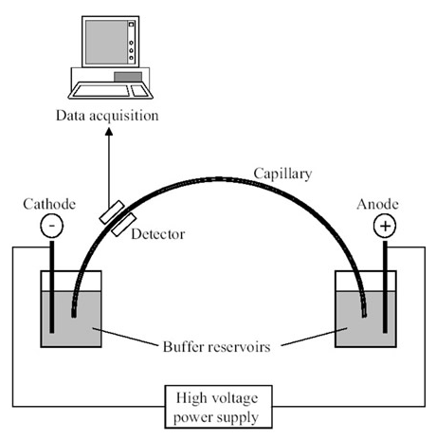
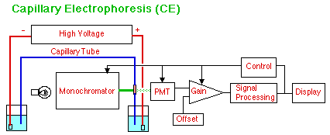
Capillary electrophoresis
http://zimmer.csufresno.edu/~davidz/Chem106/ModZoo/ModZoo.html

Slide 7
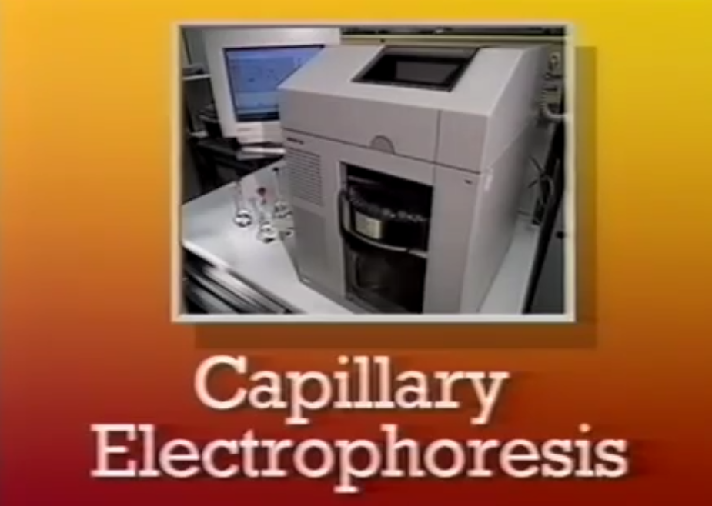

Slide 8
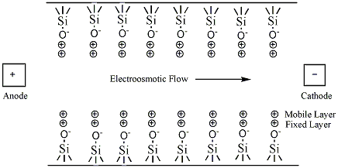
Figure 4: Depiction of the interior of a fused-silica gel capillary in the presence of a buffer solution.

Slide 9


Slide 10
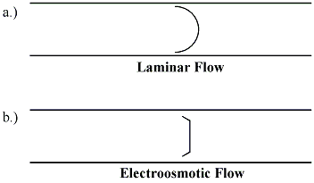
Figure 5: Flow profiles of laminar and electroosmotic flow.

Slide 11
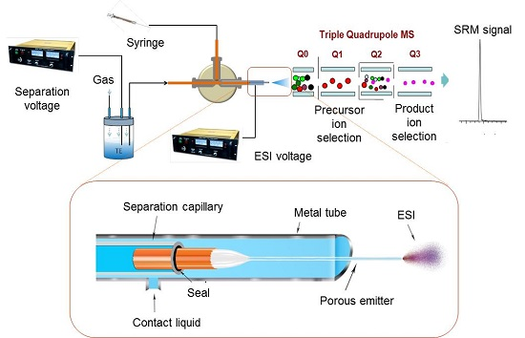

Slide 12
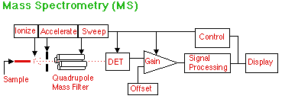
http://zimmer.csufresno.edu/~davidz/Chem106/ModZoo/ModZoo.html

