Slide 1
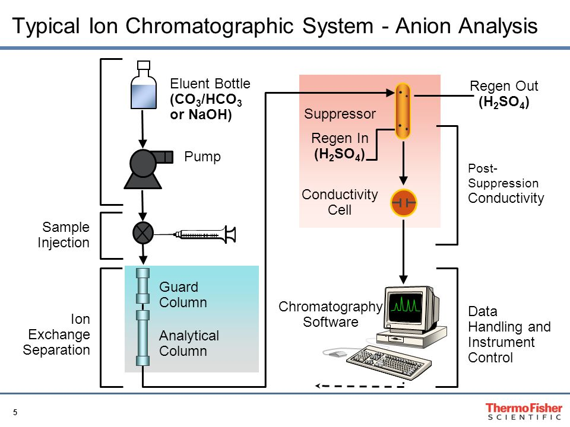
Ion Chromatography

Slide 2
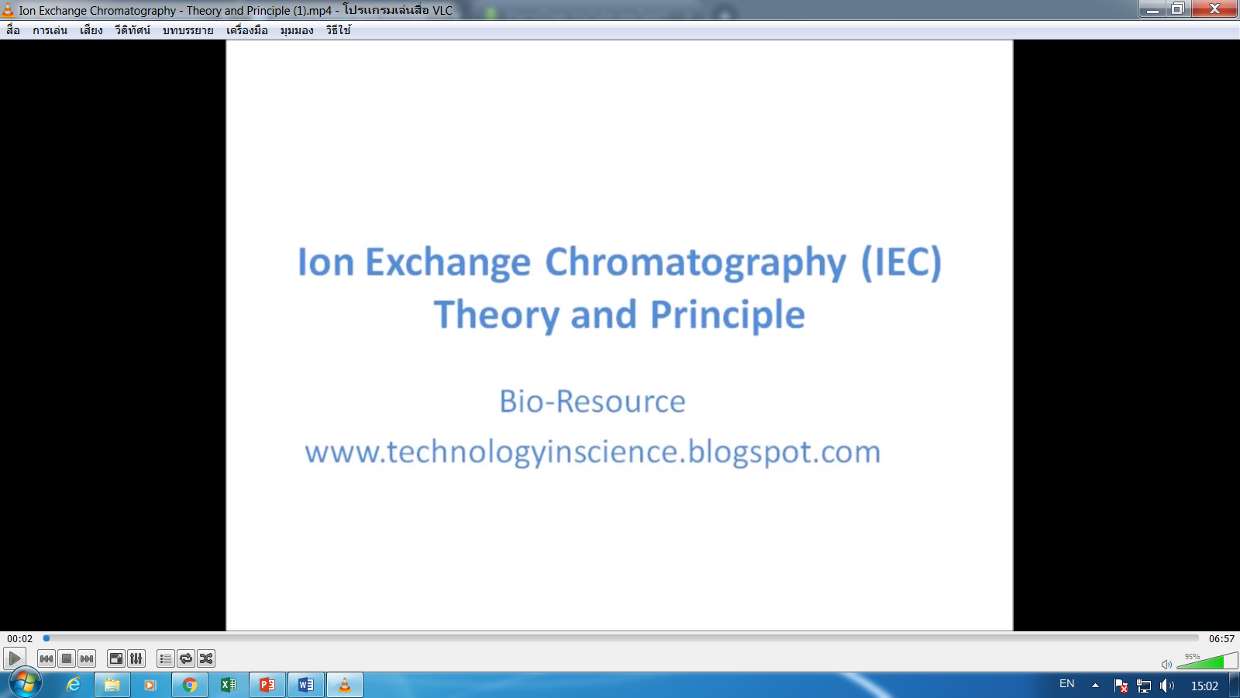
https://www.youtube.com/watch?v=A8lTfhWdAwE

Slide 3
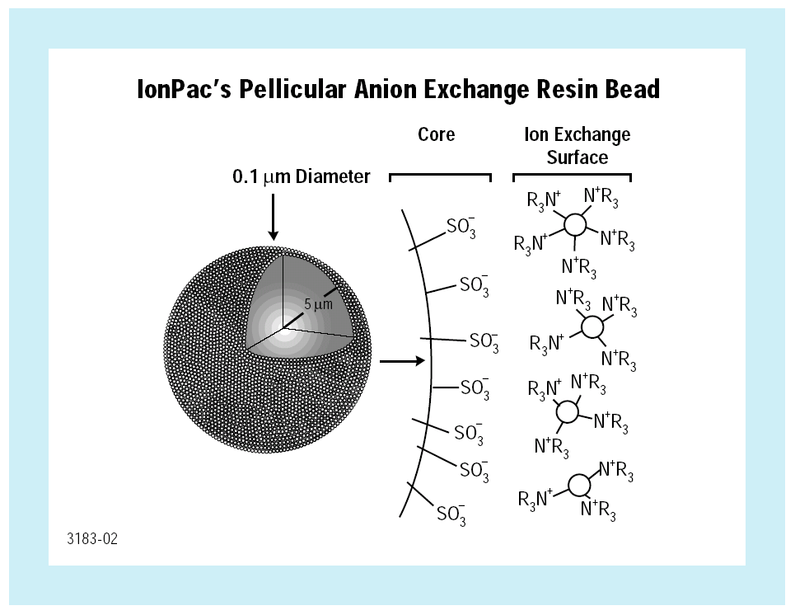
Type of ion exchange | Chemically bonded functional group
Strong cation exchange | Sulphonic acid (-SO₃H)
Weak cation exchange | Carboxylic acid (-COOH)
Strong anion exchange | Quaternary amine (-NR₃)
Weak anion exchange | Tertiary amine (-HNR₂), Secondary amine (-H₂NR)

Slide 4
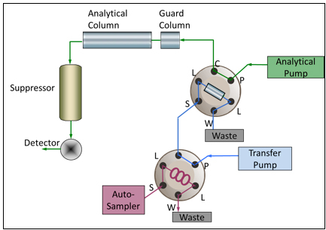
https://www.chromacademy.com/Automated-Inline-Sample-Preparation-Ion-Chromatography.html

Slide 5
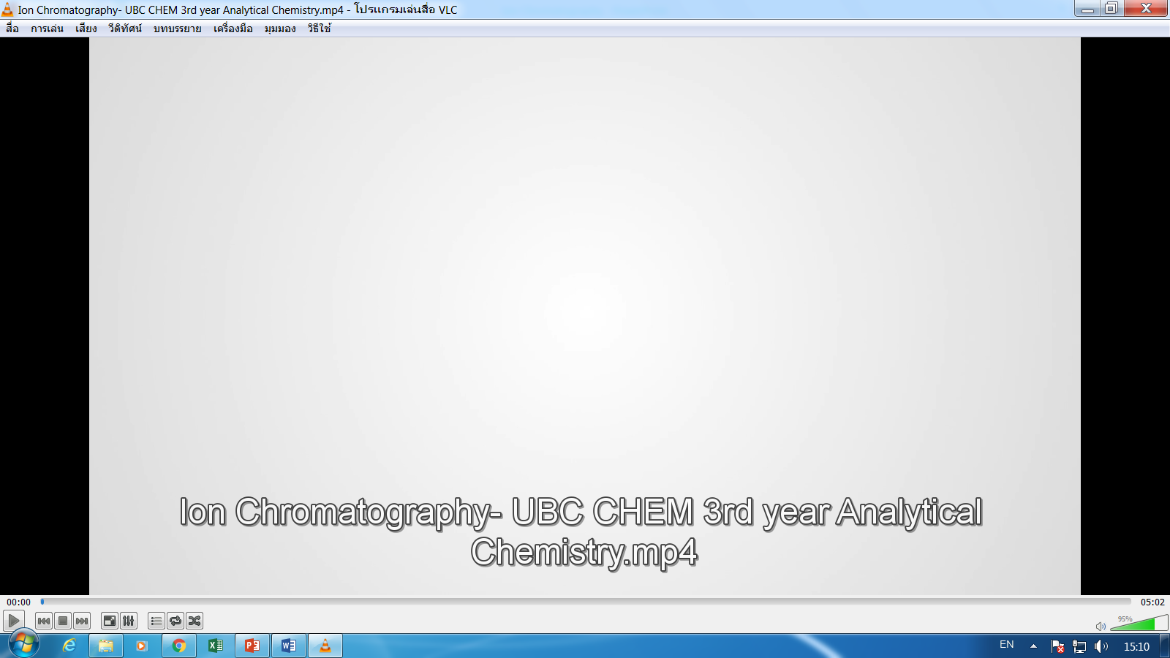

Slide 6
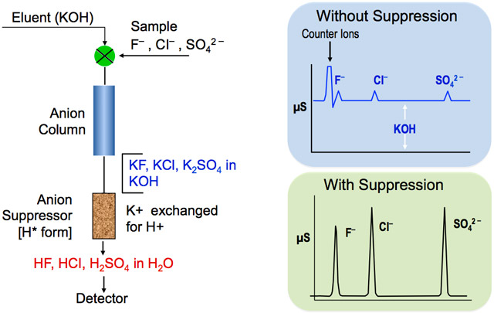
https://www.chromacademy.com/Introduction_to_Ion_Chromatography_Essential_Guide.html

Slide 7
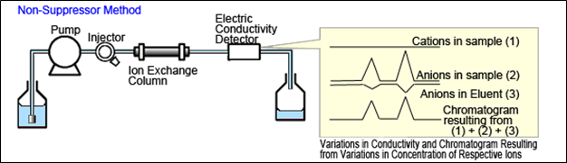
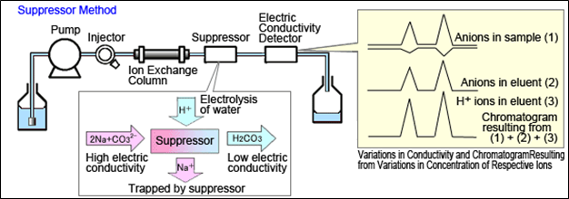
https://www.ssi.shimadzu.com/industry/environmental/lcms.html

Slide 8
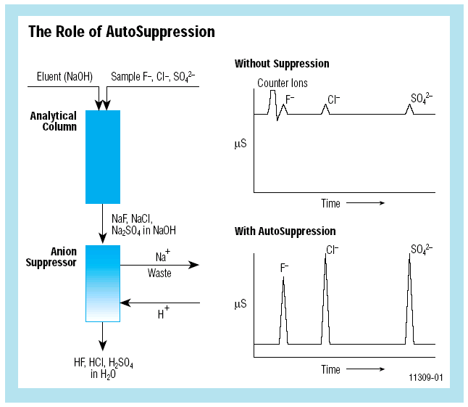

Slide 9
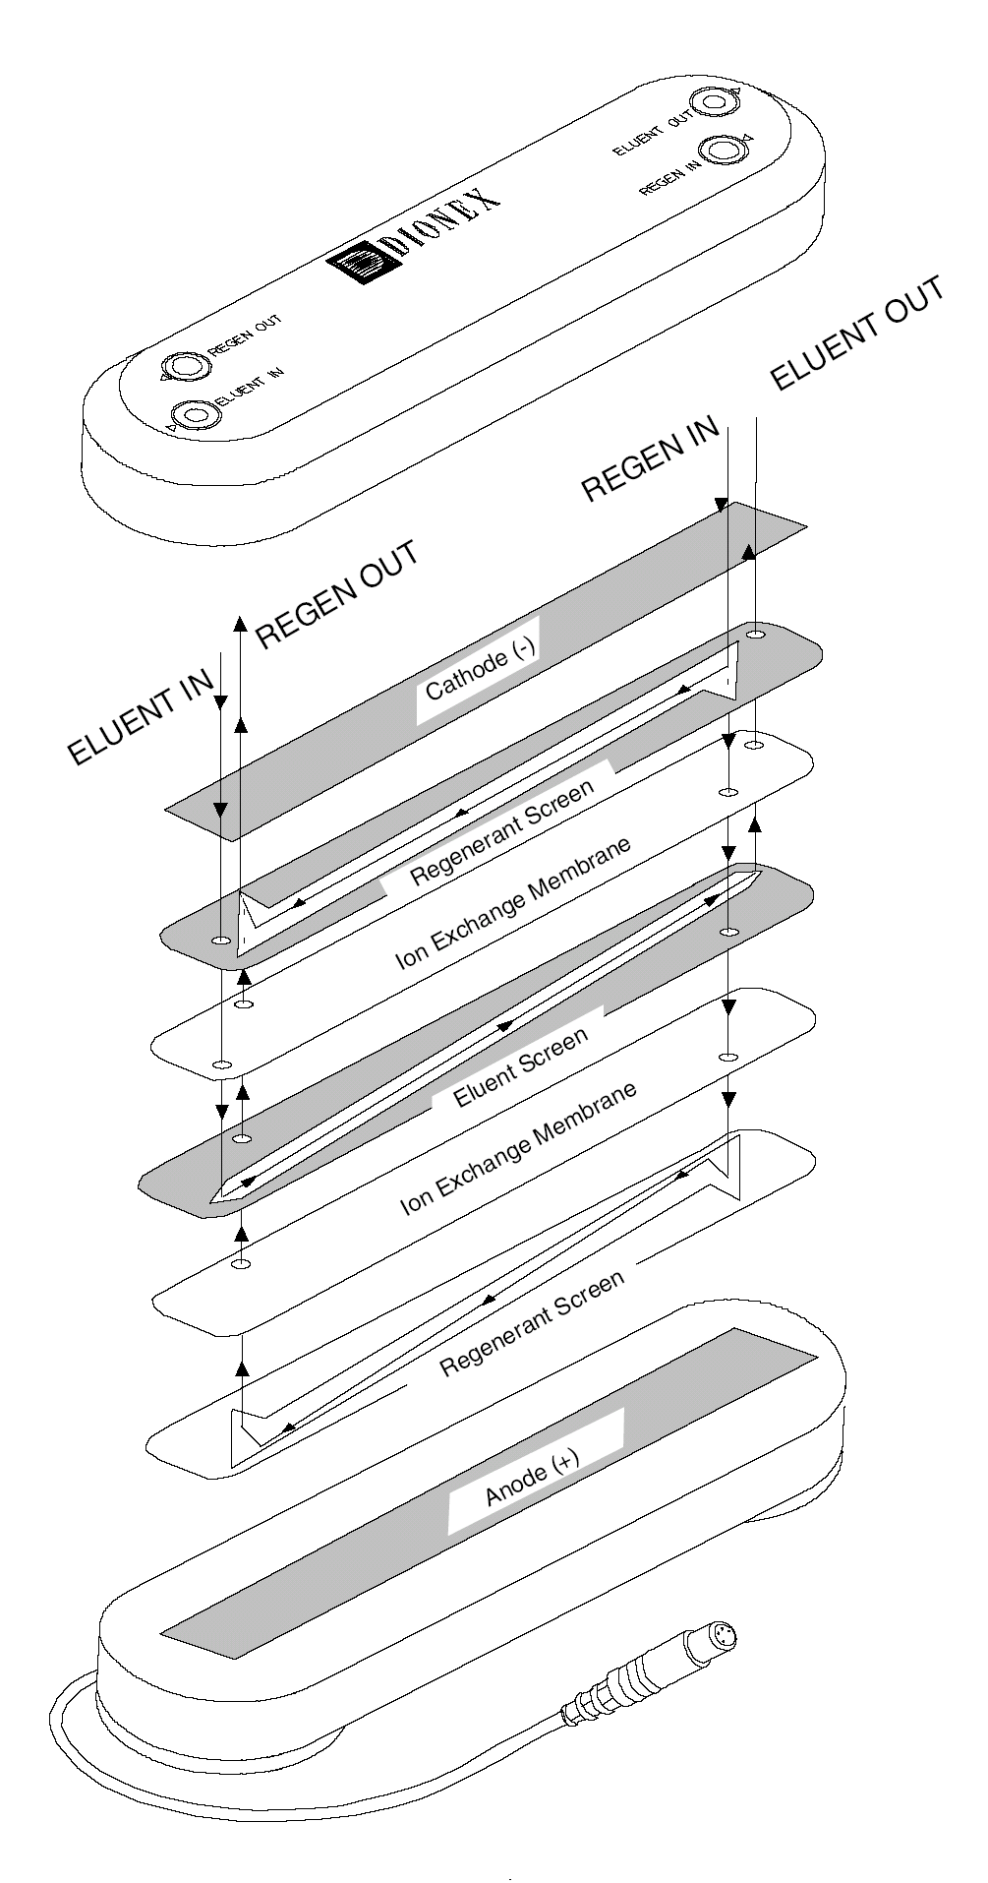
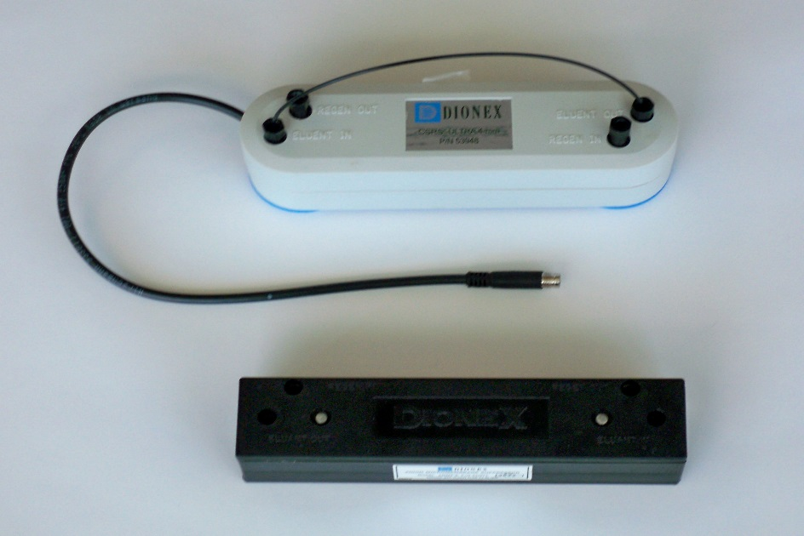
Suppressor

Slide 10
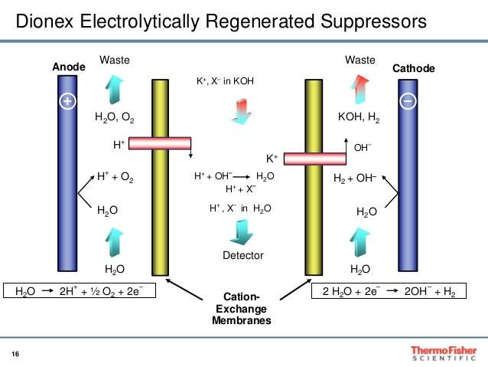

Slide 11
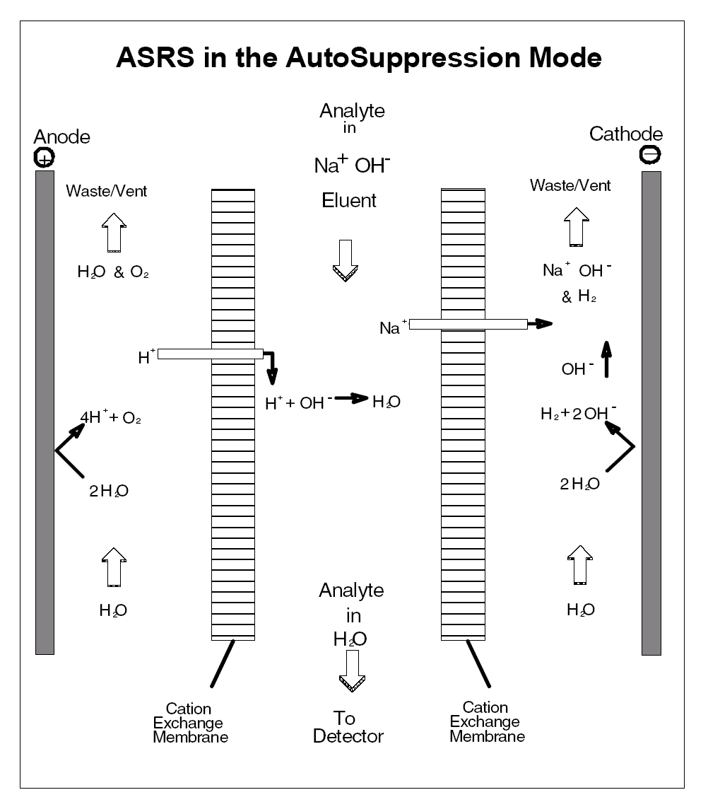
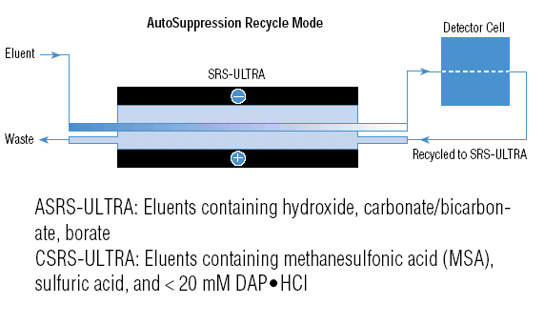

Slide 12
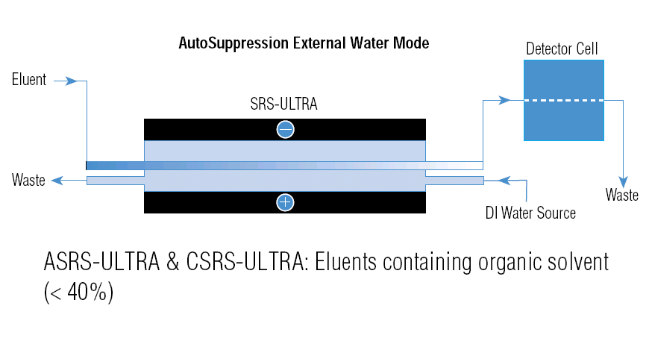

Slide 13
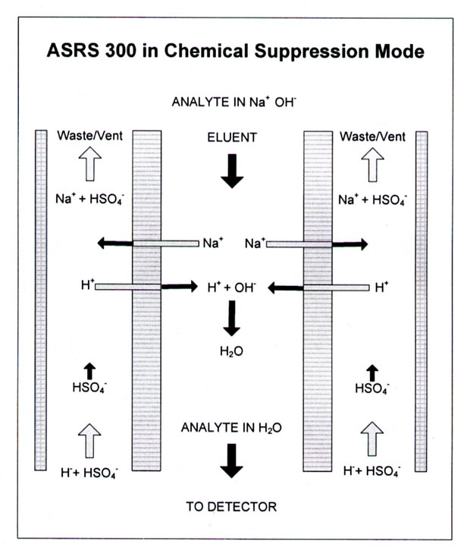
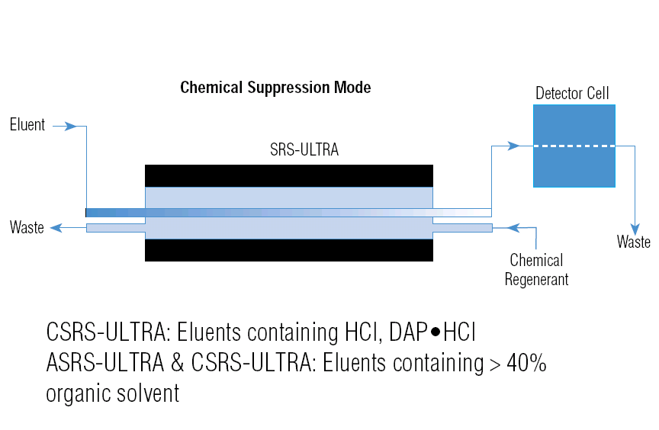
Suppressor

Slide 14
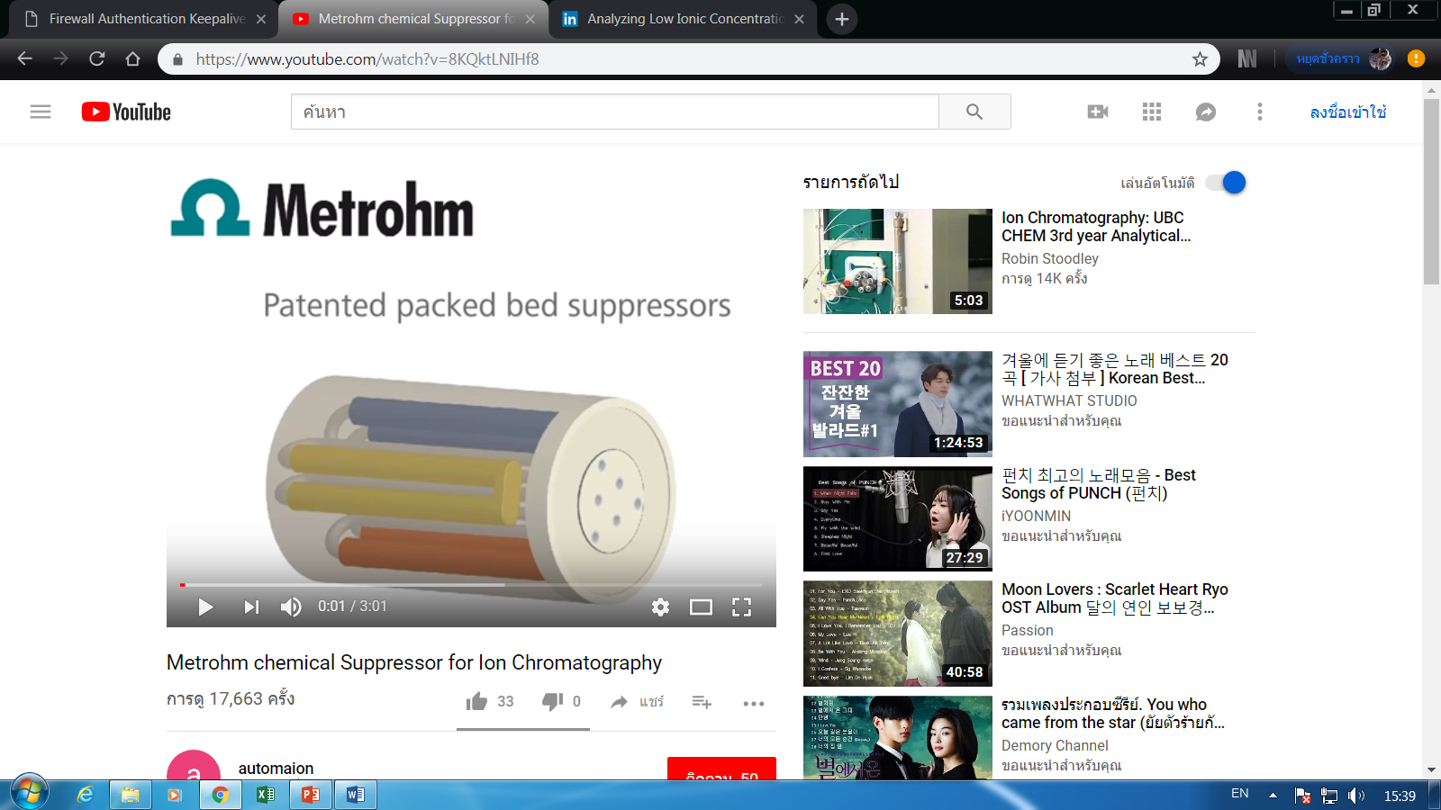

Slide 15
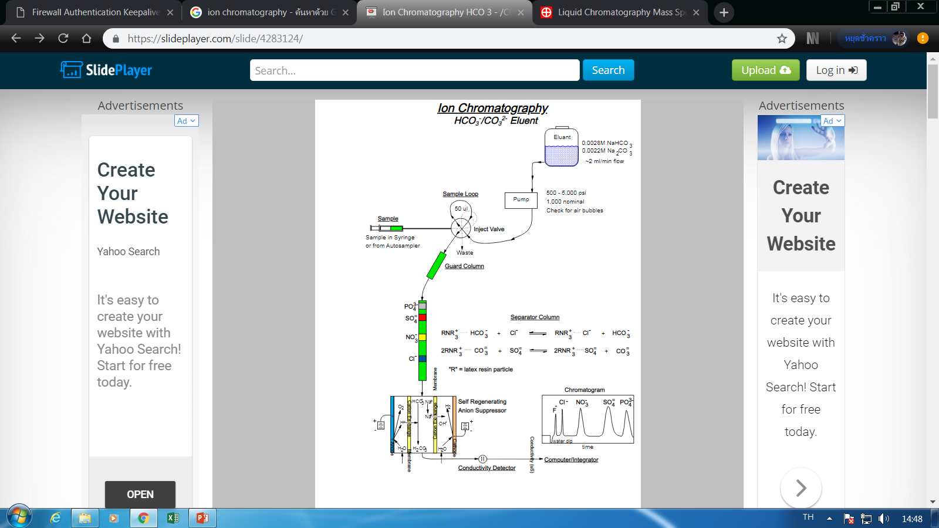

Slide 16
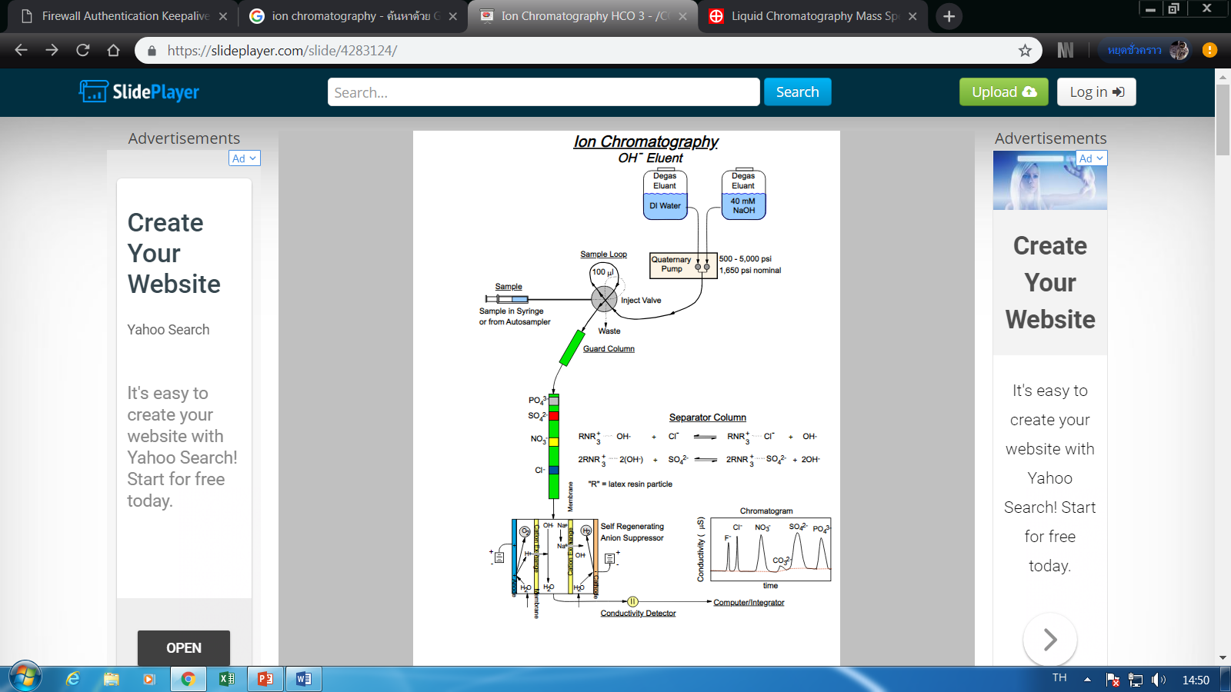

Slide 17
